Slide 1
Module 4.1 / Week 7
Tests of Controls

Slide 2
Learning Objectives
  7.1 Understand that tests of controls are undertaken when the auditor intends to rely on controls to reduce the risk of material misstatement.
  7.2 Appreciate that when undertaking tests of controls, the auditor must collect audit evidence about the existence, effectiveness and continuity of controls.
  7.3 Identify factors affecting the auditor’s assessment of the sufficiency and appropriateness of evidence provided by tests of controls.
  7.4 Describe the audit procedures for testing controls in the revenues, receivables and receipts system.
  7.5 Describe the audit procedures for testing controls in the expenditures, payables and disbursements system.
  7.6 Describe the audit procedures for testing controls relating to other types of expenditures, including contractual transactions.
  7.7 Understand the auditing approaches used to test the controls contained in the client’s computer programs, including test data and integrated test facilities.

Slide 3
LO 7.1
Tests of Controls

Slide 4
Tests of Controls
        Auditor must obtain sufficient appropriate evidence to support the assessed level of control risk (CR).
        If CR is assessed as high for an account balance or assertion, there will be no tests of controls, because auditor does not plan to rely on such controls.
        CR will be assessed as high if auditor has determined that:
                controls do not exist,
                controls that do exist will not provide reliable evidence, or
                it is more efficient or effective to gather the required evidence by undertaking substantive testing.
        The one exception, areas where substantive procedures alone may not provide sufficient appropriate evidence.

Slide 5
Assessing control risk as less than high
        When control risk is assessed as less than high, it is necessary to gather evidence that controls are working as expected.
        This evidence is gathered via tests of controls.
        If control risk is assessed as high, the auditor will not undertake test of controls.
        Auditor selects most efficient and effective combination of tests of controls, substantive tests of transactions, balances and disclosures and substantive analytical procedures

Slide 6
Planning the scope of tests of controls
Nature: refers to type of tests, tests of controls or substantive testing. Also refers to type of evidence-gathering procedures (e.g. inspection, observation).
Timing: to aid ability to meet deadlines and scheduling of staff, tests of controls are sometimes scheduled before year-end. Testing is then extended (rolled forward) until year-end.
Extent: the more the auditor relies on controls, the greater the extent of tests of controls. For tests of controls related to documents, extent is commonly determined by reference to sampling theory. Controls related to accounting routines (e.g. bank reconciliations) usually tested by re-performing a small number.

Slide 7
LO 7.2
Existence, effectiveness and continuity of controls

Slide 8
Existence, effectiveness and continuity of controls
        For internal controls to provide audit evidence about risk of material misstatements at the assertion level, the auditor must collect audit evidence about the existence, effectiveness and continuity of controls.
        Evidence of existence of controls is usually gained when auditor is assessing control risk.
        Tests of controls are aimed at establishing their effectiveness and continuity.

Slide 9
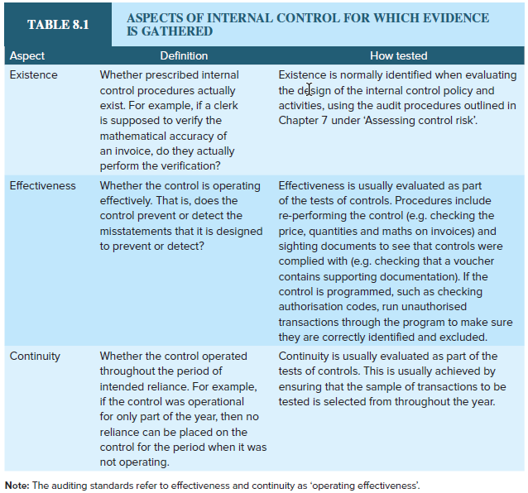
Aspects of internal control for which evidence is gathered
Source: Grant, G. & Simnett, R. (2018). Auditing & Assurance Services In Australia (7th Ed), Sydney, Australia: McGraw Hill

Slide 10
LO 7.3
Sufficiency and appropriateness of evidence

Slide 11
Sufficiency and appropriateness of evidence
  ASA/ISA 500.6 requires the auditor to consider the sufficiency (quantity) and appropriateness (quality) of audit evidence.
  This depends on the level of control risk the tests must support. The lower the planned assessed level of control risk, the greater the amount of testing that is required.
        Auditor should also consider:
        type and source of evidence
        interrelationship of evidence.

Slide 12
Effect of documentation of controls: audit trail
    The method used by auditor depends on whether a documentary audit trail exists.
    Where no audit trail exists, greater emphasis is placed on:
                observation
                enquiry of the control
    If audit trail does exist:
                inspect documentation associated with the transaction for evidence of the control.

Slide 13
Relationship between tests of controls and financial report assertions
    Auditor is required to assess risk of material misstatement at the assertion level for classes of transactions, account balances and disclosures.
    When auditor’s assessment of material misstatement at assertion level includes an expectation that controls are operating effectively, auditor should perform tests of controls to obtain evidence that the controls were operating effectively (effectiveness) during the audit (continuity).

Slide 14
Assertions and testing control elements
  For the first two elements of IC (control environment and entity’s risk assessment process), controls relate less directly to financial report assertions.
  For remaining three elements of IC (information system, control activities and monitoring of controls), controls are built around major flows of transactions and events and related accounts (e.g. sales, receivables and cash receipts).
  For these elements it is possible to link many controls to assertions (e.g. occurrence—control related to occurrence of sales transactions is an authorisation of the terms of the sale).

Slide 15
LO 7.4
Revenues, receivables and receipts (sales cycle)

Slide 16
Revenues, receivables and receipts (sales cycle)
    The sales cycle involves all those transactions and events that are initiated when an entity makes a sale.
    It is commonly characterised by a high volume of routine transactions.
    Risks of material misstatement are commonly related to high-volume clerical processing rather than complex accounting problems.

Slide 17
Key functions in typical revenue, receivables and cash receipts cycle
Sales/Accounts receivable
        order entry and order approval by credit department
        shipping
        invoicing
        accounting: sales journal, accounts receivable master file.
Accounts receivable/Cash receipts
        direct deposit to bank/mail opening
        accounting: accounts receivable master file, cash receipts journal.

Slide 18
Transactions in a revenue, receivables and receipts system
Routine transactions are credit sales to customers and receivables from customers.
They are usually well controlled, and well suited to tests of controls.
Non-routine transactions are adjustments for return of merchandise, allowances for defective merchandise and write-offs or allowances for bad debts.
Internal control systems for these transactions not usually as well developed, and therefore less likely to test controls and more likely to undertake substantive tests of transactions.

Slide 19
Test of controls for sales
Controls are in place to ensure:
Occurrence—all sales recorded are bona fide transactions for merchandise actually shipped to customers.
Completeness—all sales shipped are invoiced and recorded in accounting records.
Accuracy—invoices have been recorded correctly as to amount and summarised correctly.
Cut-off—invoices have been recorded in correct period.
Classification—sales classified in accordance with
written policies.
Presentation—sales are appropriately aggregated or disaggregated and clearly described, and related disclosures are relevant and understandable.

Slide 20
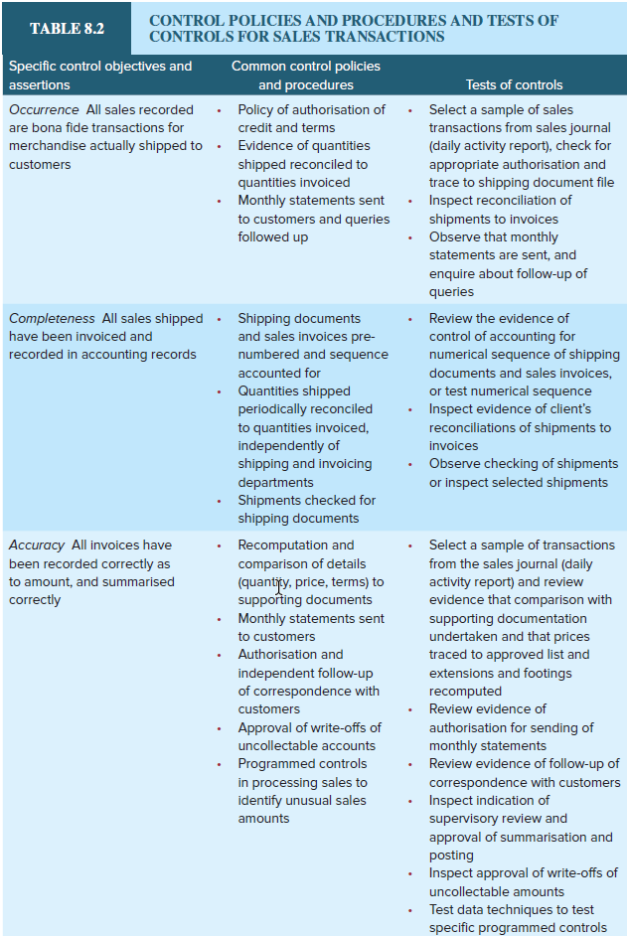
Example of linking control objectives to control policies and tests of controls: Sales
Source: Grant, G. & Simnett, R. (2018). Auditing & Assurance Services In Australia (7th Ed), Sydney, Australia: McGraw Hill

Slide 21
What if the test of controls suggests that the control is not working?
    The auditor may undertake the tests of controls and find that the necessary degree of reliance cannot be placed on the control to reduce the risk of material misstatement to an acceptable level.
    Auditor will then attempt to identify a compensating control that will reduce the risk of material misstatement, and test this control.
    If there is no compensating control, auditor will have to revise audit program and undertake substantive procedures aimed at assessing the impact of this particular risk.

Slide 22
Test of controls for cash receipts
Controls are in place to ensure:
Occurrence- recorded cash receipts are for collection of receivables resulting from sales to customers of the entity.
Completeness - all cash receipts are recorded and deposited.
Accuracy - cash receipts have been recorded correctly as to amount.
Cut-off - cash receipts have been recorded in correct period.
Classification - cash receipts are classified in accordance with company policy.
Presentation- cash receipts are appropriately aggregated or disaggregated and clearly described, and related disclosures are relevant and understandable.

Slide 23
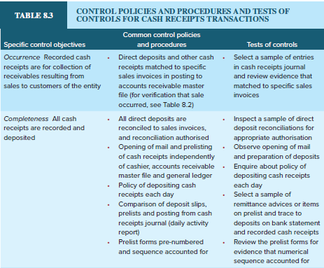
Example of linking control objectives to control policies and tests of controls: cash receipts
Source: Grant, G. & Simnett, R. (2018). Auditing & Assurance Services In Australia (7th Ed), Sydney, Australia: McGraw Hill

Slide 24
Potential misstatements
Generally the result of:
                clerical mistakes
                employee fraud
                misapplied accounting principles, especially around some revenue recognition issues.

Slide 25
LO 7.5
Expenditures, payables
and disbursements

Slide 26
Expenditures, payables and disbursements
    Expenditure cycle: all transactions and events are initiated when an entity acquires assets or uses services for cash or credit.
    This cycle is often separated into a number of sub-cycles, reflecting the various types of services and assets that can be acquired, including:
              payroll costs
              property and equipment
              inventory
              company-related taxes
              selling and administrative expenses
              miscellaneous expenses paid from petty cash.

Slide 27
Differences from the sales cycle
    Concurrent testing of disbursements and acquisitions to aid efficiency
    With more accounts, increased concern with classification of debits
    Differences between accounts payable (detecting understatement) and accounts receivable (detecting overstatement)

Slide 28
Functions, documents, inputs and accounting systems
    Purchasing from approved suppliers
    Receiving of purchased goods
    Accounts payable, including recording the purchase and the account payable
    Payments department, including recording the payment and reducing the account payable

Slide 29
Voucher system
    A type of expenditure accounting system is called a voucher system.
    A voucher system is designed to improve control over disbursements by establishing a sequential pre-numbered record of suppliers’ invoices and to improve efficiency by eliminating inessential record keeping and facilitating timing of payments.
    The documents that form the voucher package are the purchase order, receiving report and supplier’s invoice. Once these three documents are received and reviewed, the voucher can be processed for payment.

Slide 30
Test of controls for purchases of inventory
Controls are in place to ensure:
Occurrence—all recorded purchases are bona fide transactions in that they relate to goods or services authorised or received.
Completeness—all purchases for the period of inventory received are recorded.
Accuracy—purchases of inventory are recorded correctly as to amount and summarised correctly.
Cut-off—purchase invoices have been recorded in correct period.
Classification—purchases are classified in accordance with classification policies.
Presentation—purchases are appropriately aggregated or disaggregated and clearly described, and related disclosures are relevant and understandable.

Slide 31
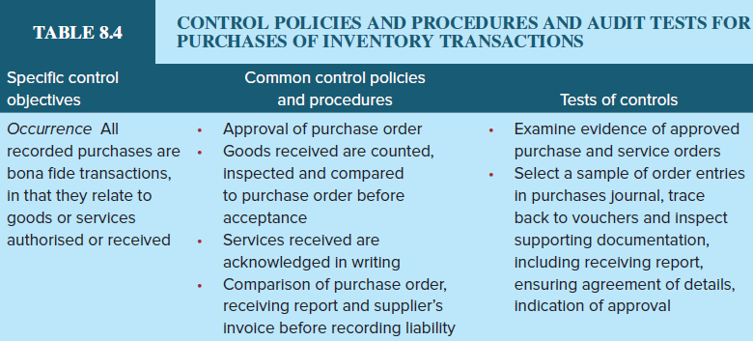
Example of linking control objectives to control policies and test of controls: purchases
Source: Grant, G. & Simnett, R. (2018). Auditing & Assurance Services In Australia (7th Ed), Sydney, Australia: McGraw Hill

Slide 32
Test of controls for cash disbursements
Controls are in place to ensure:
Occurrence—recorded cash disbursements are for goods or services authorised and received.
Completeness—all cash disbursements are recorded.
Accuracy—cash disbursements are recorded correctly as to amount.
Cut-off—cash disbursements recorded in correct period.
Classification—cash disbursements are recorded correctly as to account.
Presentation—cash disbursements are appropriately aggregated or disaggregated and clearly described, and related disclosures are relevant and understandable.

Slide 33
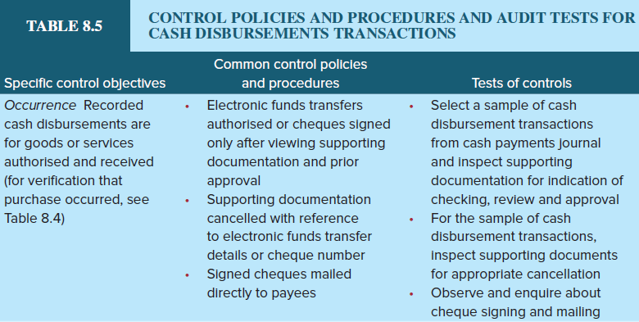
Example of linking control objectives to control policies and test of controls: cash disbursements
Source: Grant, G. & Simnett, R. (2018). Auditing & Assurance Services In Australia (7th Ed), Sydney, Australia: McGraw Hill

Slide 34
Potential misstatements in expenditure cycle
    As the expenditure cycle involves disbursements of cash there is a greater risk of fraud or irregularity, including:
    classic disbursements fraud
    kickbacks
    illegal acts
    unauthorised executive perks
    kiting.

Slide 35
Test of controls for other types of expenditure transactions
Payroll
    The payroll function is usually audited in either of two ways (or best combination):
      focusing on analytical procedures (disaggregated and strong relationships in this area, e.g. comparing fortnightly payrolls)
      tests of transactions over the payroll area with a key control being appropriate segregation of duties in the hiring, approval of time worked, and payroll preparation and distribution functions.

Slide 36
Payroll
Test of controls for other types of expenditure transactions
If tests of controls are necessary, the following audit procedures may be undertaken:
      authorisation by supervisors of time worked
      check signed time cards/sheets
      check use of approved pay rates (personnel department)
      check for reasonableness, compared with awards.

Slide 37
LO 7.7
Testing controls in client computer programs

Slide 38
Testing controls in client computer programs
    Separate techniques have to be developed
    for testing automated controls (discussed in Chapter 7).
    These are:
                test data
                integrated test facility
                processing client data
                reviewing program code or results of job processing
                advanced data analytics.

Slide 39
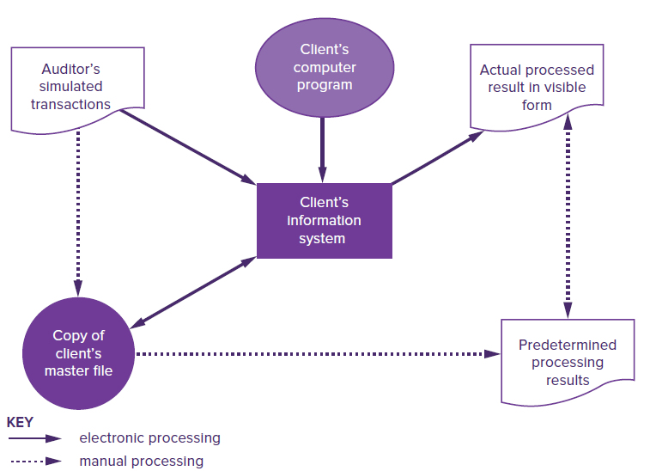
Processing test data
Source: Grant, G. & Simnett, R. (2018). Auditing & Assurance Services In Australia (7th Ed), Sydney, Australia: McGraw Hill

Slide 40
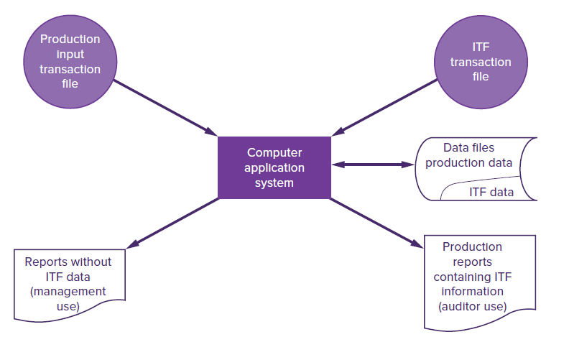
Integrated test facility
Source: Grant, G. & Simnett, R. (2018). Auditing & Assurance Services In Australia (7th Ed), Sydney, Australia: McGraw Hill

Slide 41
References
Grant, G. & Simnett, R. (2017). Auditing & Assurance Services In Australia (rev: 6th Ed), Sydney, Australia: McGraw Hill
Moroney, R., Campbell, F., & Hamilton, J., (2017). Auditing: A Practical Approach, (3rd ed), Sydney, Australia: Wiley

